Slide 1
weather
At our arrival at the bus station was a gentleman looking for us. Introduced himself and that he had been sent by Linda to pick us. Helps us with our staff into the car and off we start our journey leading us to the place of our destination.
The weather was really cold because it had been raining. I could feel it in my deep stomach.

Slide 2

The dream land
Reached Kilimani in twenty minutes
Driver hoots at closed gate, he opens and tells him he has brought students at AkiraChix.
Welcomed by a beautiful ,quiet environment.

Slide 3

A warm welcome
We were welcomed by Linda who was in her words like, hey girls! Welcome to AkiraChix. Introduced us to a young lady, helped us with our staff and asked each one of us to write her names on the piece of paper pleased with hospitality which made me feel at home yet I was in a foreign land.

Slide 4
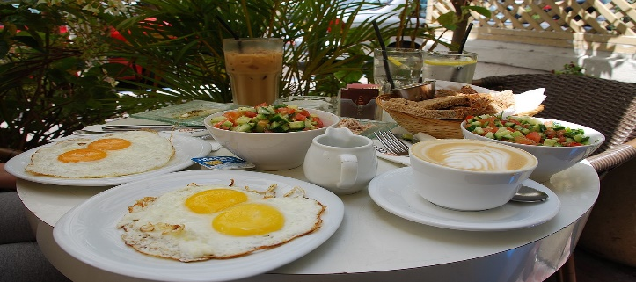
A place to be
asked to go in a room where I found four ladies again. Another welcome and introduction.
A short interview then I was taken to my room where I would be sleeping.
Called for breakfast which enlightened my moods because I was hungry.

Slide 5

MY FIRST EXPERIENCE AT AKIRACHIX
new person in a new country. It was at around 9:30am that every thing around me had changed, for example my money was no longer important since there was a change in currency, language spoken, people, the roads and finally the country and the president. Interesting though.

Slide 6
Time is no man’s friend
Before we realized, had lunch and had a general meeting with the administrators, incoming students and the former students.
Introduction began with who you were, place your coming from and your expectations for year 2020
Concluded with rules and regulations guiding AkiraChix
I had supper then went to bed.

